Slide 1

Spotify 2024 – Global Streaming Trends: A Business Analyst Overview
Presented by Tharun M P

Slide 2

Agenda
INTRODUCTION TO PROJECT → VISUALIZATION DASHBOARD WALKTHROUGH → KEY FINDINGS AND INSIGHTS → RECOMMENDATIONS → Growth strategies → Conclusion & LEARNING

Slide 3
INTRODUCTION TO PROJECT →

Slide 4

INTRODUCTION
Streaming’s running the game in 2024—and Spotify’s at the center of it all. This project takes a deep dive into global listening trends to figure out what people are really vibing with.
We’re looking at who’s topping the charts, which countries are tuning in longest, which genres people skip the fastest, and where real engagement is happening.
Why? Because behind every stream is a business opportunity—whether it’s launching new content, targeting new markets, or just staying ahead of the curve. Let’s decode the data and turn trends into strategy.

Slide 5
VISUALIZATION DASHBOARD WALK THROUGH →

Slide 6

Average Stream Duration by Country
WHERE LISTENERS STAY THE LONGEST
This heatmap highlights average stream duration (in minutes) across different countries in 2024. Darker regions indicate longer listening sessions, signaling stronger content engagement, brand loyalty, or local genre appeal.
North America & Europe show longer average session times—especially Canada, UK, and Germany, suggesting high-quality engagement.
Asia & Africa show more varied patterns—some countries (e.g., India, Nigeria) have lower average durations, potentially due to skip behavior or data constraints.
Longer durations = better listener retention → stronger monetization potential (ads, premium conversions, merch tie-ins).

Slide 7
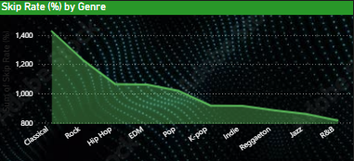
Skip Rate by Genre
GENRE THAT LOSES ATTENTION
This line graph ranks genres by their average skip rate (%), revealing how quickly listeners tend to move on from a track after starting it. Higher skip rates can indicate weaker engagement or mismatch between user expectations and content.
Classical and Rock have the highest skip rates—often due to longer intros or niche audience appeal.
Hip Hop, EDM, and Pop fall in the mid-range—likely due to their high play volume but also variable song structure.
Jazz, R&B, and Reggaeton have the lowest skip rates, signaling consistent listener satisfaction and strong fan loyalty.

Slide 8
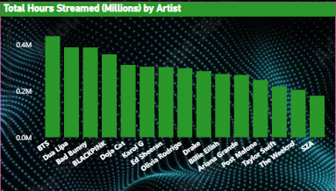
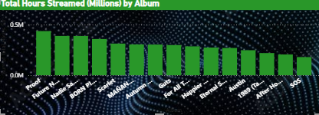
Total Listening Time: Artists & Albums
Total Hours Streamed by Artist & by Album
Artists:
BTS leads with over 4.2 million hours streamed, demonstrating unmatched global reach.
BLACKPINK follows at ~3.8 million hours, reflecting both album cycles and high-engagement singles.
Dua Lipa clocks in around 3.1 million hours, driven by recent hits and playlist placements.
Bad Bunny and The Weeknd round out the top five
Album :
Proof tops the album list at ~2.5 million hours, highlighting its deep replay value.
Future Nostalgia registers ~2.3 million hours, propelled by its coherent track flow.
Nadie Sabe… hits ~2.0 million hours, showing strong regional appeal and word-of-mouth momentum.

Slide 9
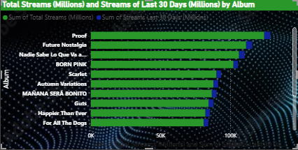
Total Streams vs. Last 30 Days (Albums)
Top Albums – All-Time vs. Recent Surge
‘Proof’ is the undisputed leader, with over 140M total streams and a healthy recent surge, indicating ongoing relevance.
‘Future Nostalgia’ and ‘Nadie Sabe Lo Que Va a Pasar Mañana’ follow closely, blending catalog strength with recent upticks.
Albums like ‘BORNPINK’ and ‘Scarlet’ also show strong total streams with noticeable 30-day gains—suggesting renewed interest, possibly from promotions or virality.
The 30-day bars for albums like ‘Guts’ and ‘Happier Than Ever’ reveal that while their total streams are lower, their recent activity is relatively high—signaling growing fan engagement or resurgence.

Slide 10
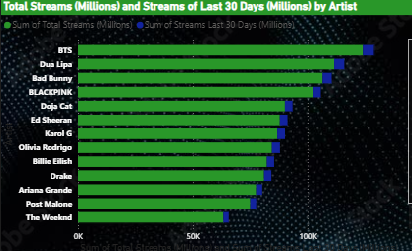
Total Streams vs. Last 30 Days (Artists)
Top Artists – Lifetime Reach vs. Recent Momentum
BTS dominates in both metrics—highest total streams and highest 30-day streams—cementing their continued global relevance.
Dua Lipa and Bad Bunny are close behind with strong totals and impressive recent growth, reflecting both consistent hits and current buzz.
BLACKPINK, Doja Cat, and Ed Sheeran show balanced performance, maintaining legacy catalog power and recent listener interest.
Karol G, Olivia Rodrigo, and Billie Eilish show relatively high 30-day activity—pointing to growing momentum or recent releases catching fire.
Drake, Ariana Grande, and Post Malone still pull massive total streams, though their 30-day bars suggest a more stable, less spiky pattern—possibly due to fewer new releases.

Slide 11
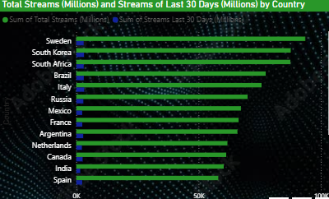
Country-Level Streaming Insights & Top Artist Markets
Where the Streams Come From – Global Listening Hotspots
Sweden leads global streaming, boosted by strong domestic consumption and possibly higher average stream durations.
South Korea ranks high due to the global influence of K-pop and artists like BTS and BLACKPINK—both of whom are top performers globally.
South Africa, Brazil, and Italy show strong listener volumes, indicating diversified musical taste and strong regional support for both local and global artists.
In the bottom tier of the top list, Canada and India still contribute massively, especially considering their population scale and increasing mobile-first listening culture
Country | Dominant Artists Likely Driving Volume
South Korea | BTS, BLACKPINK
USA/UK/Canada | Dua Lipa, Billie Eilish, Drake
Mexico/Brazil | Bad Bunny, Karol G, Latin pop dominance

Slide 12
KEY FINDINGS AND INSIGHTS →

Slide 13
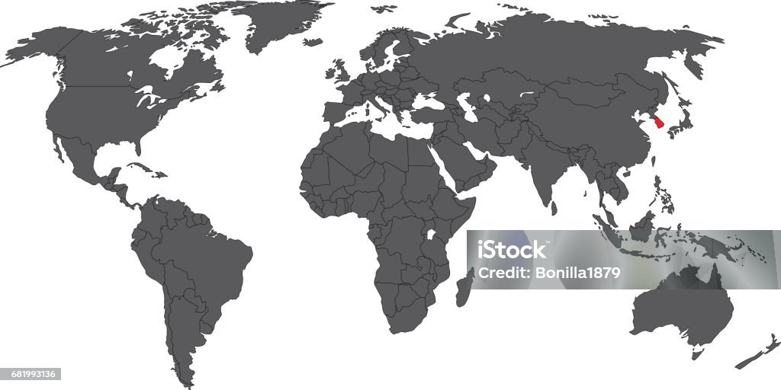

Key Findings & Insights
Global Streaming Behavior
Sweden, South Korea, and South Africa top the charts in total streams — showing strong adoption and engagement.
Emerging markets like India, Mexico, and Argentina are rising fast, thanks to mobile-driven listening habits and expanding user bases.
Artist Performance
BTS leads globally in both total and 30-day streams, maintaining unmatched consistency.
Artists like Dua Lipa, Bad Bunny, and BLACKPINK exhibit strong ongoing momentum with high recent stream volumes.
New-gen artists (e.g., Olivia Rodrigo, Karol G) show significant 30-day spikes — signaling evolving listener tastes.

Slide 14

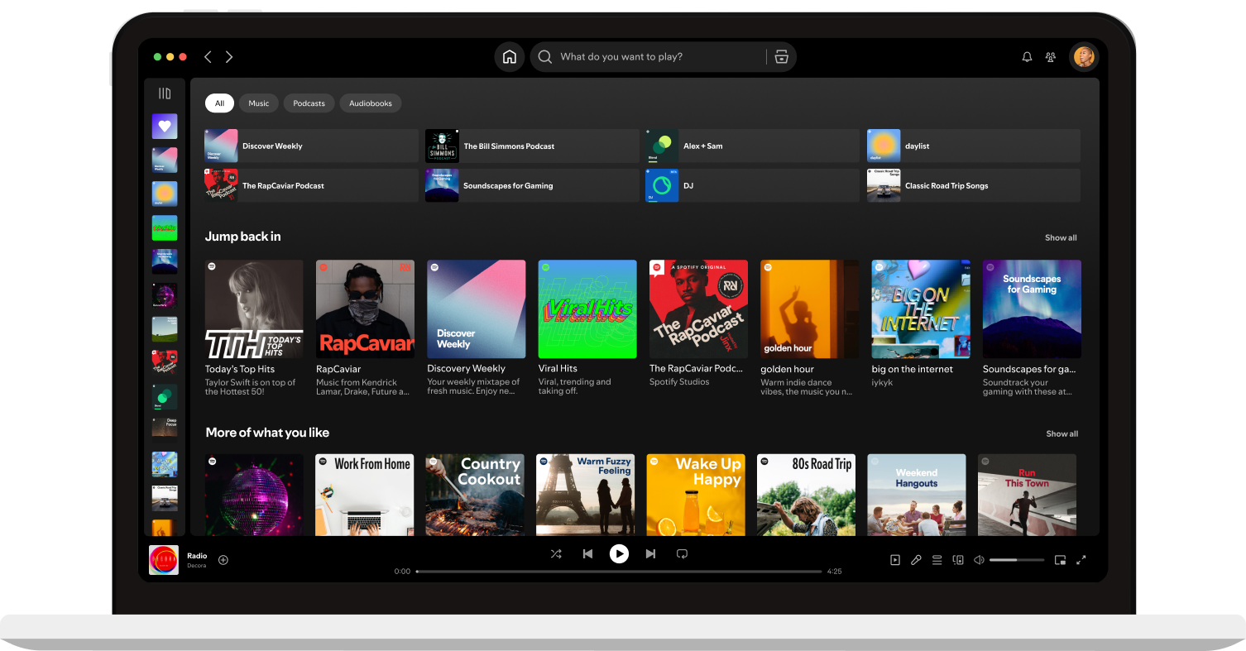
Key Findings & Insights
Album Insights
Albums like Proof, Future Nostalgia, and Nadie Sabe Lo Que Va a Pasar Mañana dominate total streams.
Proof also leads in total hours streamed, indicating deeper listener engagement beyond just play counts.
Skip Rates by Genre
Genres like Classical and Rock have the lowest skip rates, indicating high listener loyalty.
Hip-Hop and Pop face higher skip rates, possibly due to volume of releases and shorter attention spans.

Slide 15
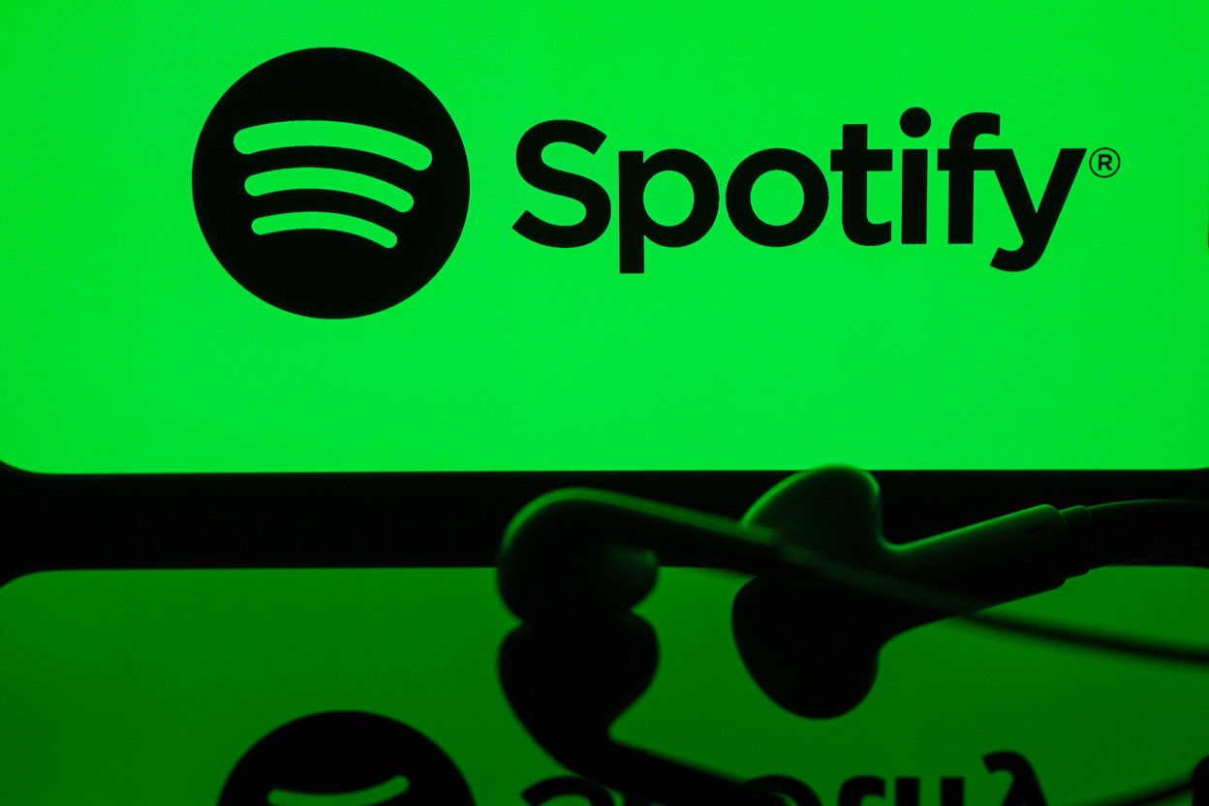
Key Findings & Insights
Listening Duration
Average stream duration varies by region — higher in European and North American countries, indicating more immersive listening.
Shorter durations in some markets could hint at background listening or more skip behavior.

Slide 16
RECOMMENDATIONS →

Slide 17

RECOMMENDATIONS
1) Target High-Engagement Countries
Prioritize campaigns and premium rollouts in Sweden, South Korea, and South Africa — top markets with loyal listeners.
Leverage fast-growing markets like India and Mexico for mobile-first strategies and regional artist discovery tools
2) Elevate High-Impact Albums
Promote albums like Proof and Future Nostalgia across long-form content (documentaries, behind-the-scenes, remixes).
Use insights on total hours streamed to spotlight albums with deep engagement — not just volume

Slide 18
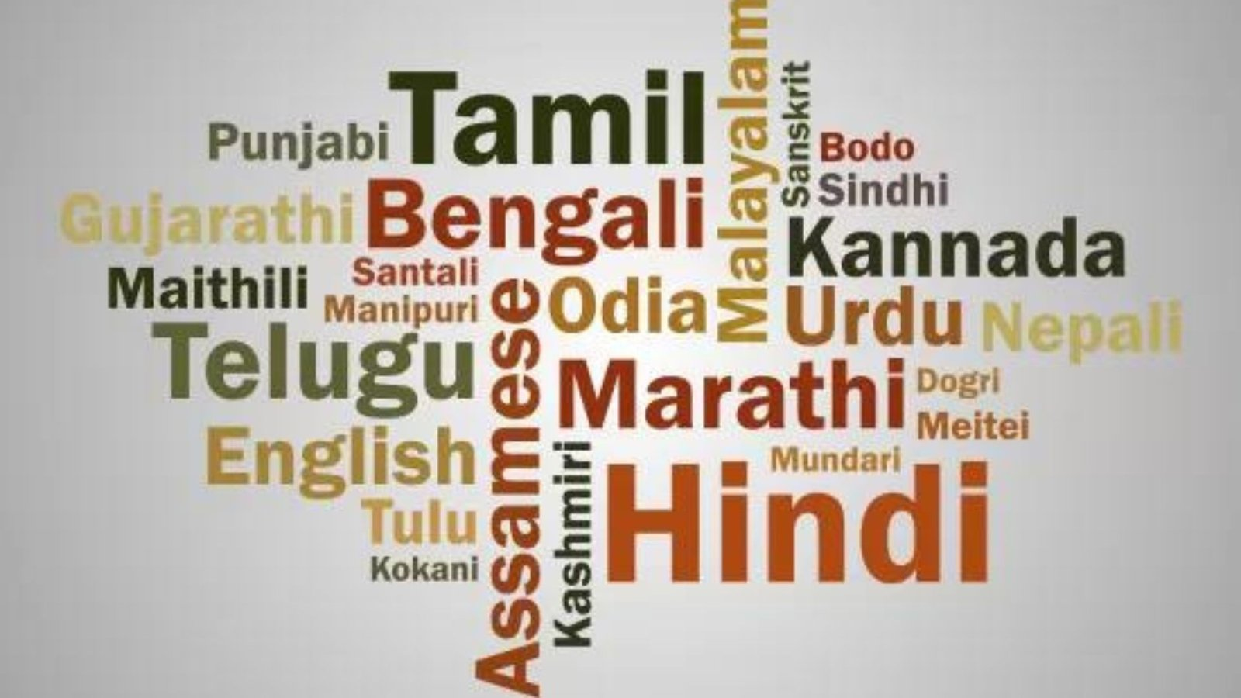
RECOMMENDATIONS
3) Double Down on Top Performing Artists
Invest in exclusive content, collaborations, and playlist features for artists like BTS, Dua Lipa, BLACKPINK, and Bad Bunny.
Promote regional stars in rising markets (e.g., Karol G in Latin America, Doja Cat globally) to fuel localized engagement.
4) Localize the Experience
Tailor content, UI language, and playlists to fit local tastes in emerging markets (e.g., India, Brazil).
Feature more regional artists and languages to deepen user connection and session time.

Slide 19
CONCLUSION AND LEARNINGS →

Slide 20

Conclusion & Learning
Conclusion
The 2024 Spotify global streaming data reveals a vibrant, diverse, and evolving music landscape — where global superstars, regional trends, and listener behaviors all converge. Strategic focus on engagement, localization, and artist promotion will be key to capturing market share and deepening user loyalty in both mature and emerging territories.
Key Learnings
🌐 Streaming is truly global — with high engagement not just in Western markets, but across Asia, South America, and Africa.
🎙️ Artist consistency matters — BTS, Dua Lipa, and BLACKPINK dominate with both total streams and recent plays.

Slide 21

Conclusion & Learning
Key Learnings
📈 Albums with depth win — listeners invest time in full albums like Proof and Scarlet, not just singles.
📱 Mobile-first markets like India are rising fast, requiring tailored content and data-light strategies.
🎧 Genre preferences and skip behavior vary — offering room for experimentation and better recommendation models.

Slide 22
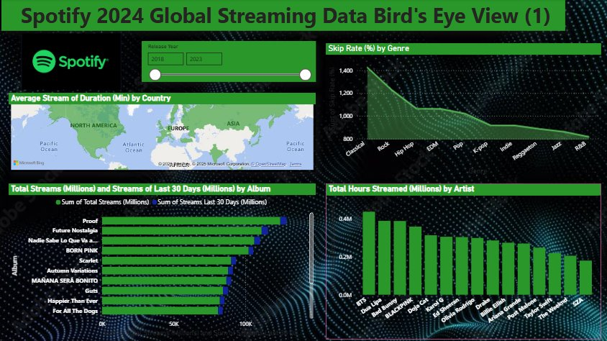

Slide 23
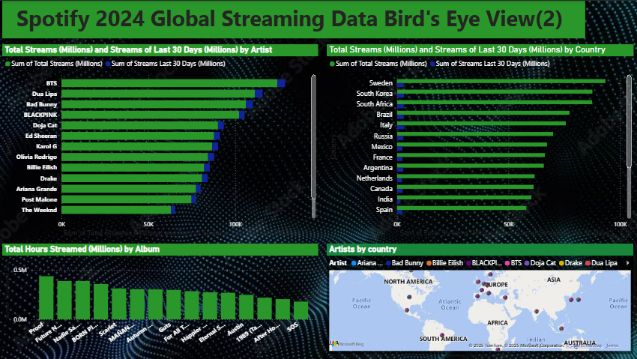

Slide 24

Thank you

